Slide 1
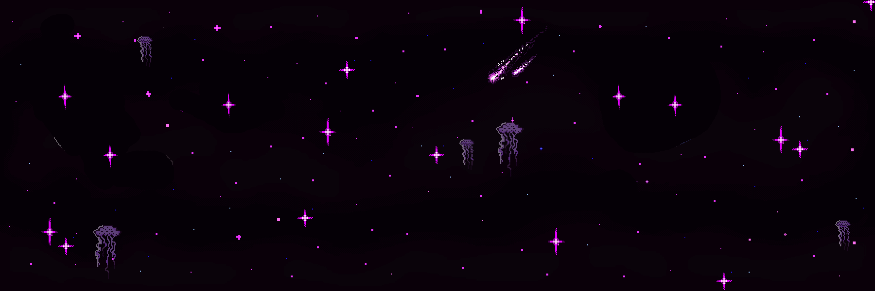
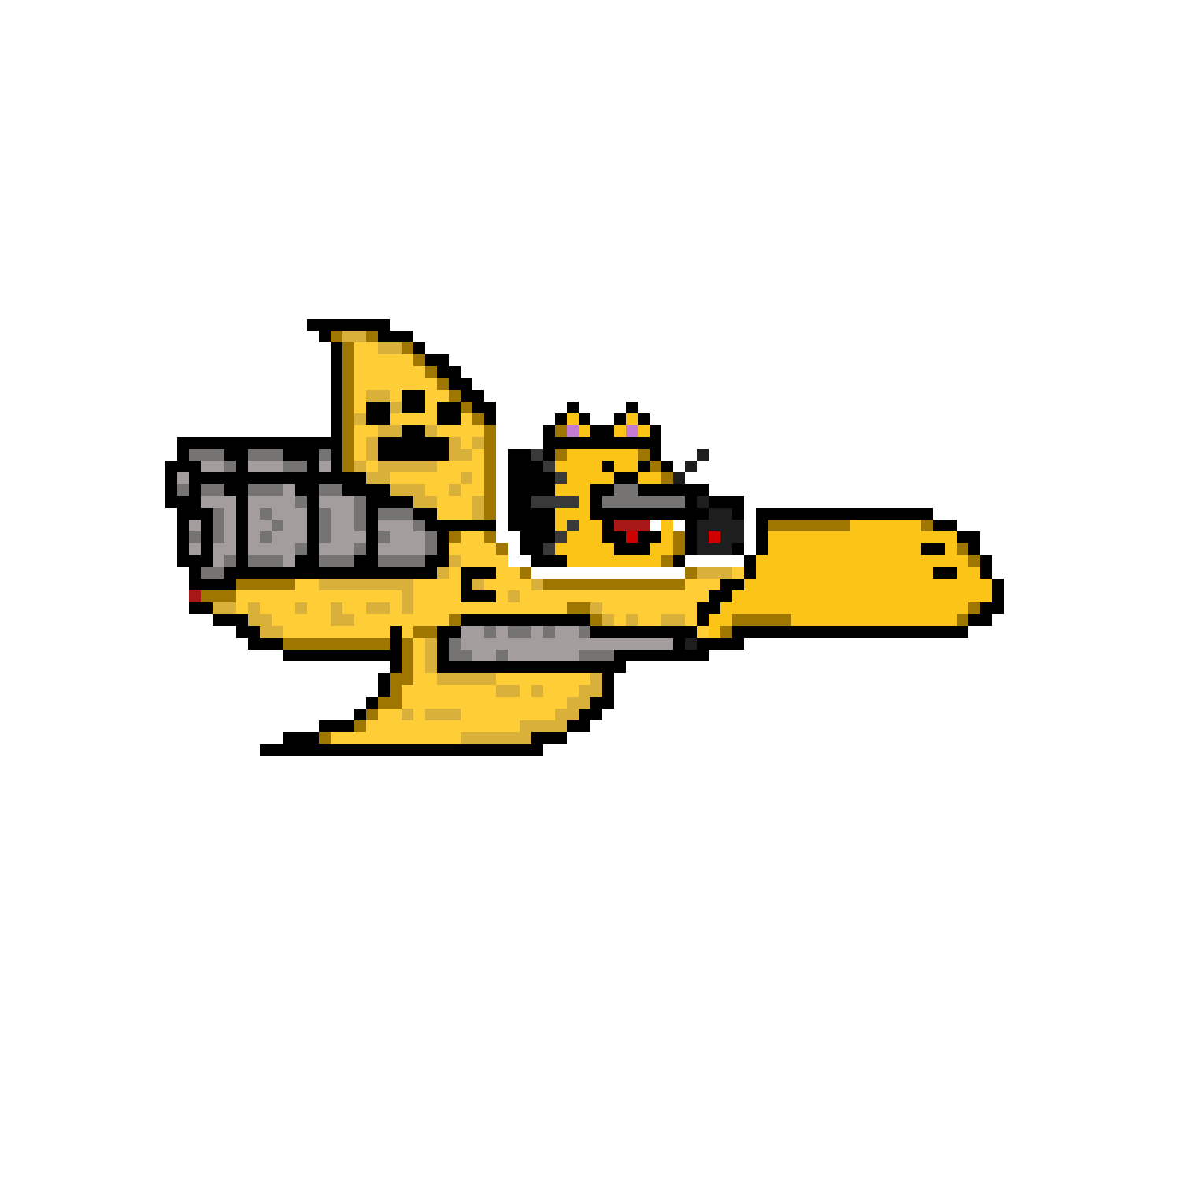

Slide 2
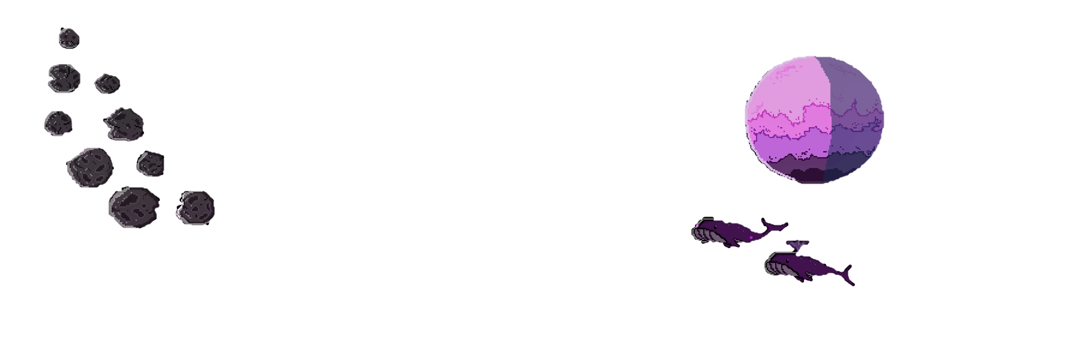

Slide 3
CATTYPUSS
ODYSSEY
Members:
Chua, Stanford
Ong Chua, Nurico Jay
Rajah, Khashrafy

Slide 4
CATTYPUSS
ODYSSEY
Members:
Chua, Stanford
Ong Chua, Nurico Jay
Rajah, Khashrafy

Slide 5
PART I
INTRODUCTION

Slide 6
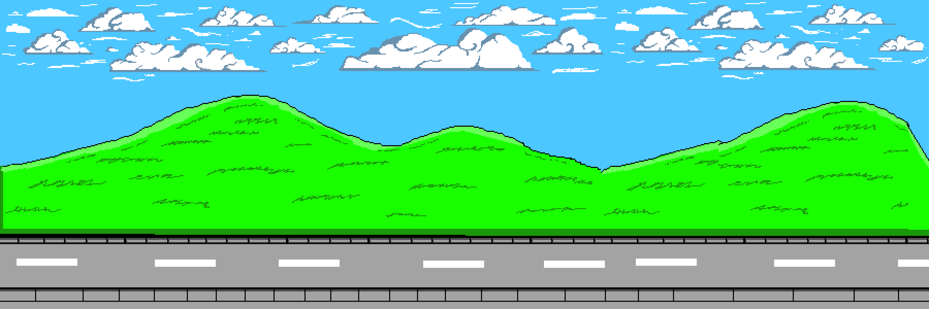

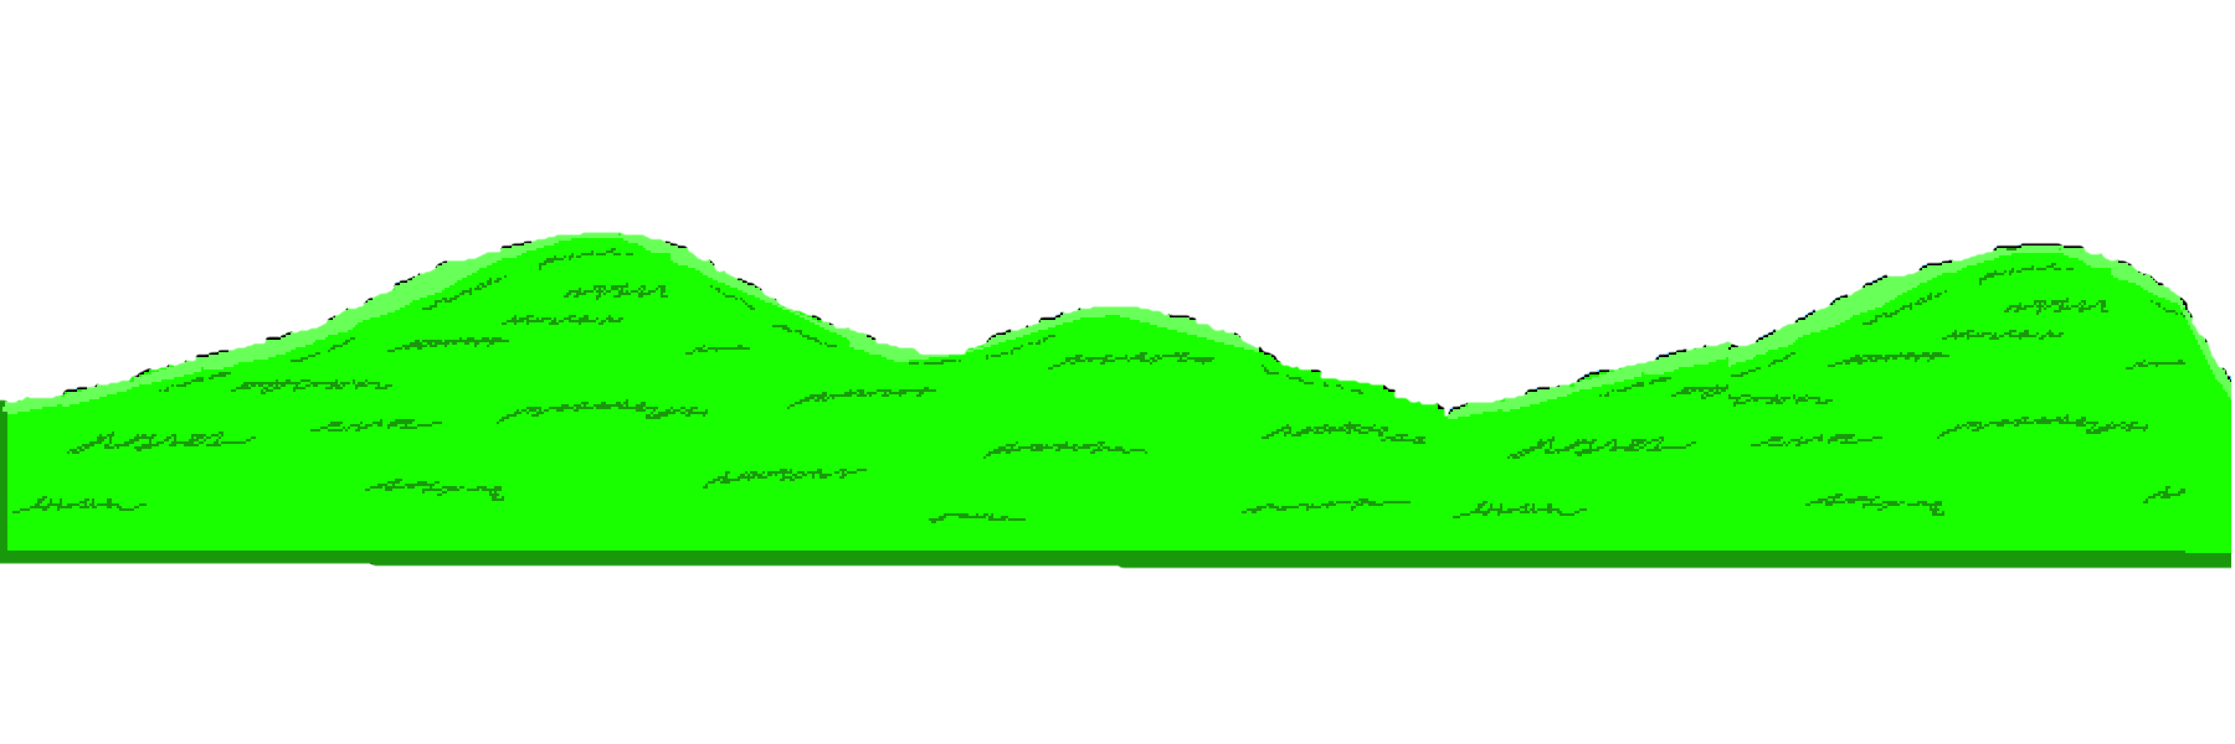
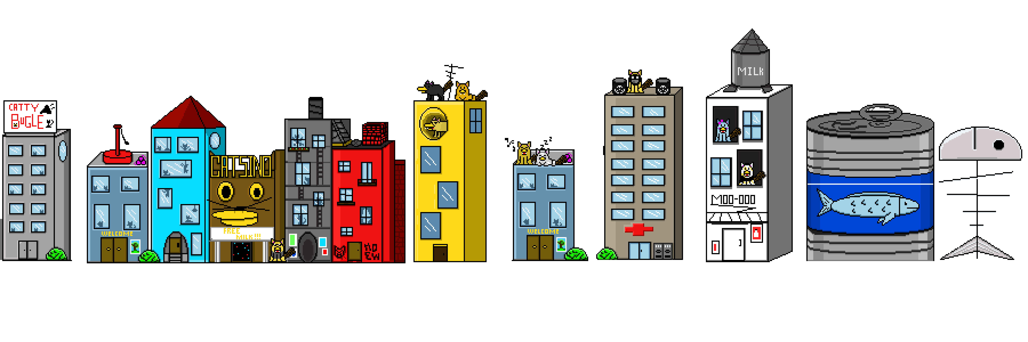
GENRE AND STYLE
Genre
- Its a side-scrolling shoot 'em up video game
STYLE
- THE game is a retro-inspired., pixelated arcade shooter., THAT FEATURES engaging gameplay and a nostalgic aesthetic

Slide 7
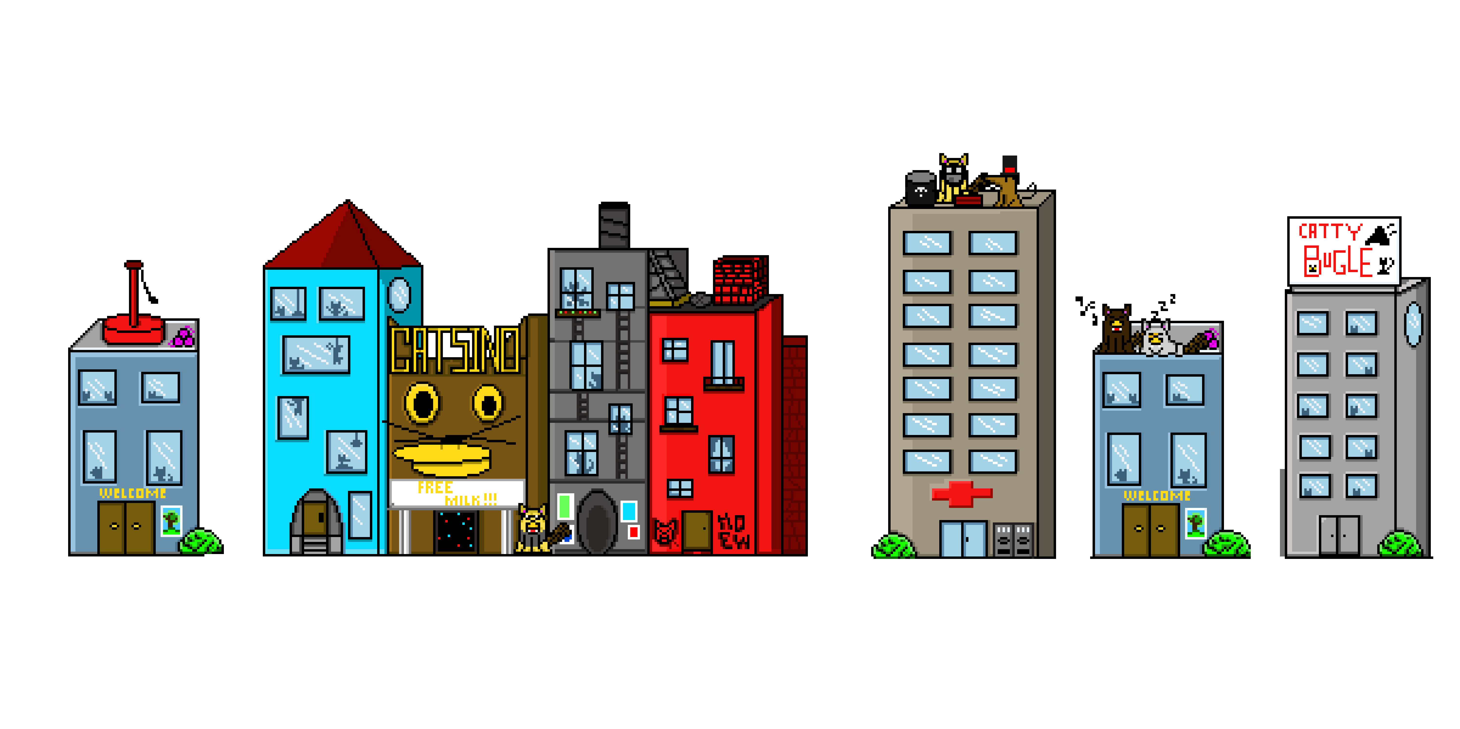
GENRE AND STYLE
Genre
- Its a side-scrolling shoot 'em up video game
STYLE
- THE game is a retro-inspired., pixelated arcade shooter., THAT FEATURES engaging gameplay and a nostalgic aesthetic

Slide 8
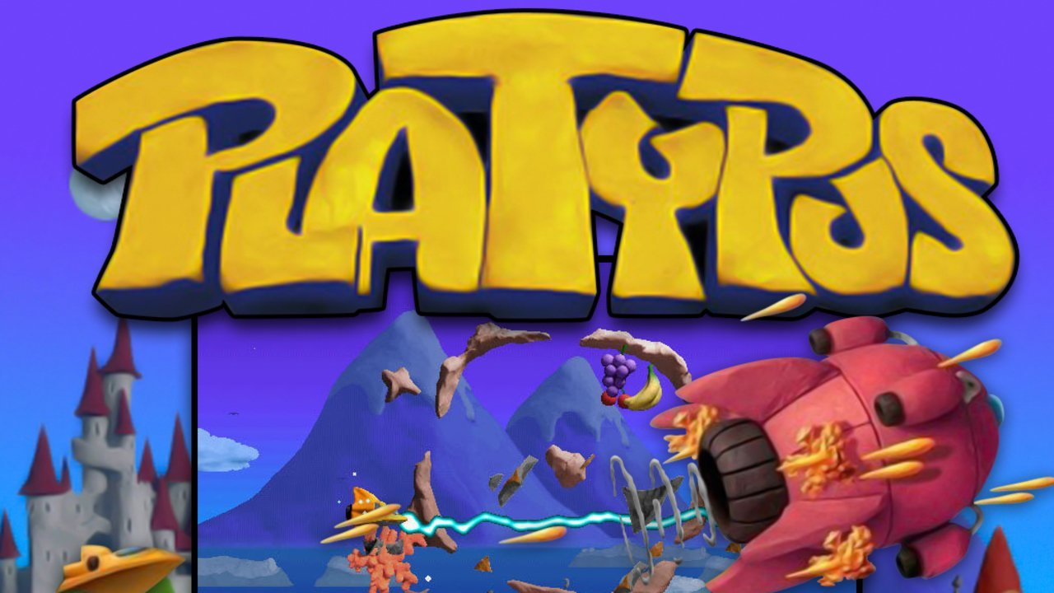
inspiration
PLATYPUS (2002

Slide 9
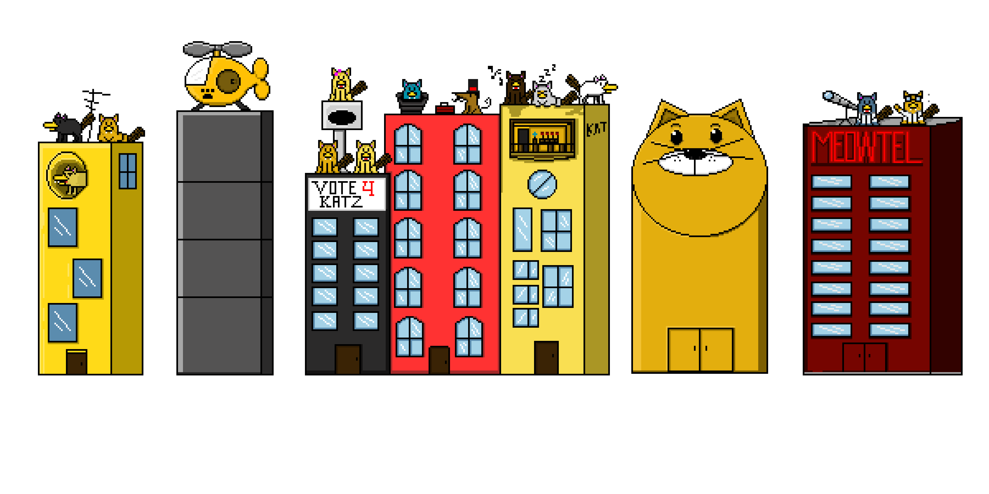
inspiration
PLATYPUS (2002

Slide 10
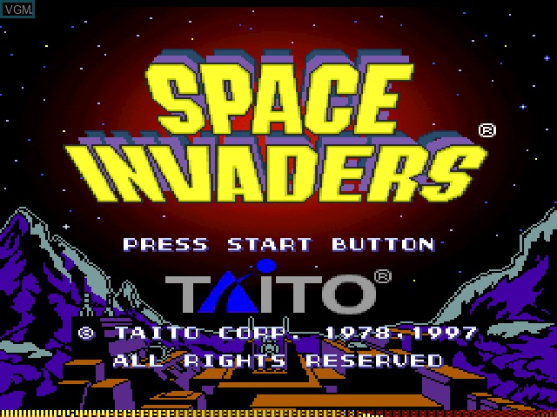
INSPIRATION
SPACE INVADERS 1978-1997

Slide 11
INSPIRATION
SPACE INVADERS 1978-1997

Slide 12
PART Ii
PROJECT B.G.

Slide 13

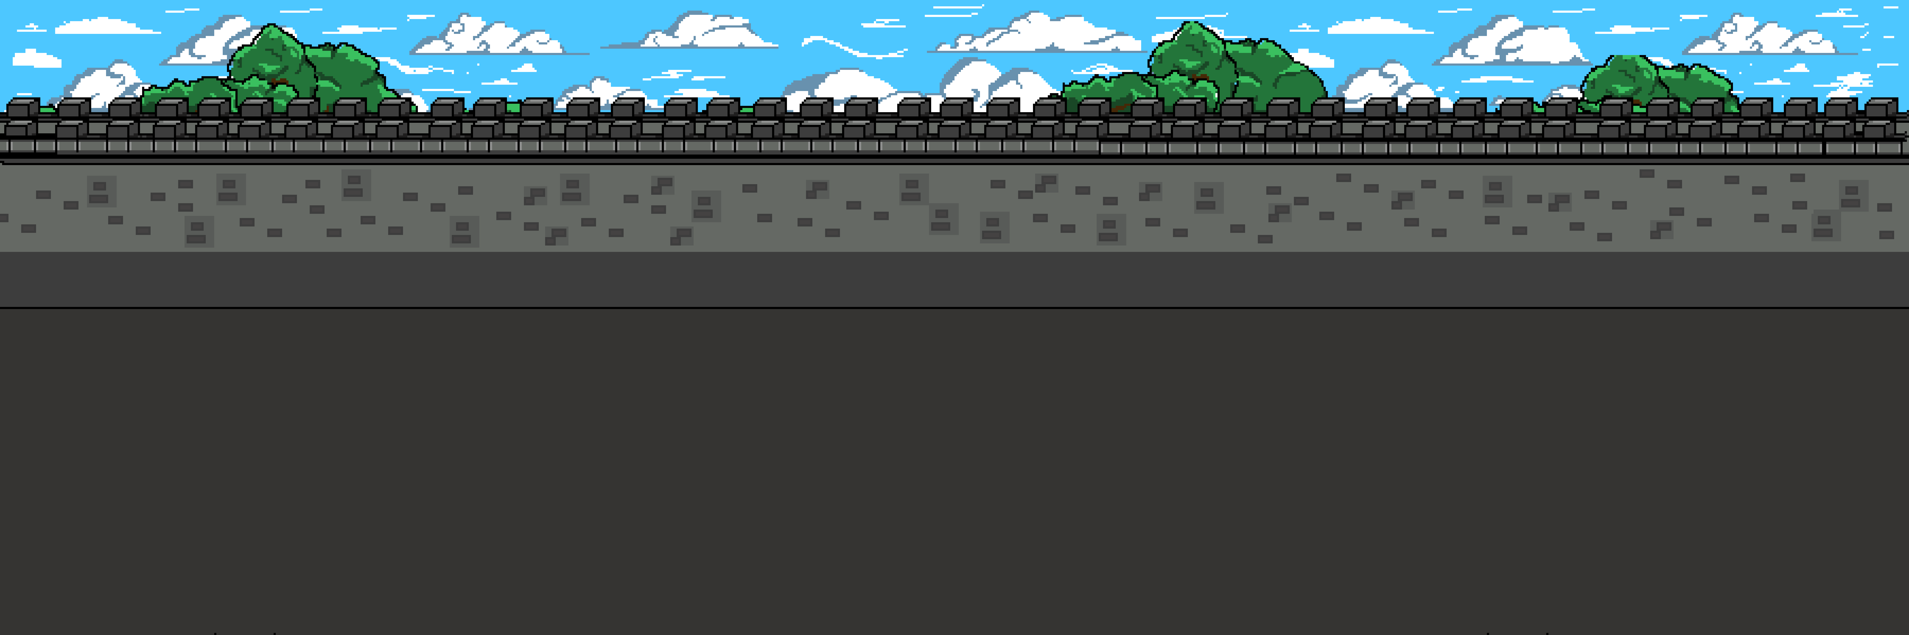
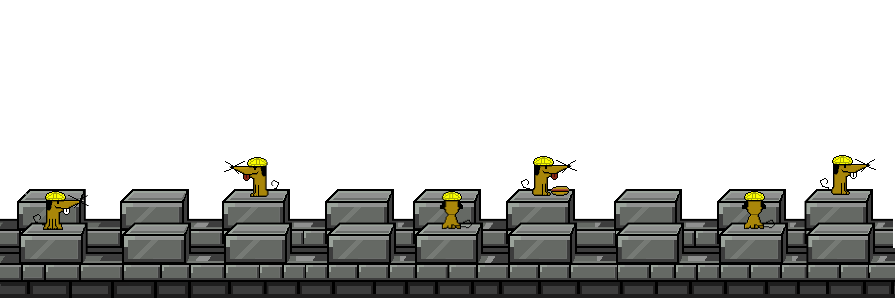


CONTEXT
We created this game with a dual purpose in mind.
-: to offer a delightful and brief gaming experience for enthusiasts who cherish the nostalgic charm of side-scrolling shoot 'em ups, akin to the classic days of Platypus.
- Our endeavor is not only a tribute to the beloved Platypus but also a passionate effort to reignite the appreciation for side-scrolling shooters, fostering a renewed love for the genre among both seasoned players and a new generation of gamers.

Slide 14
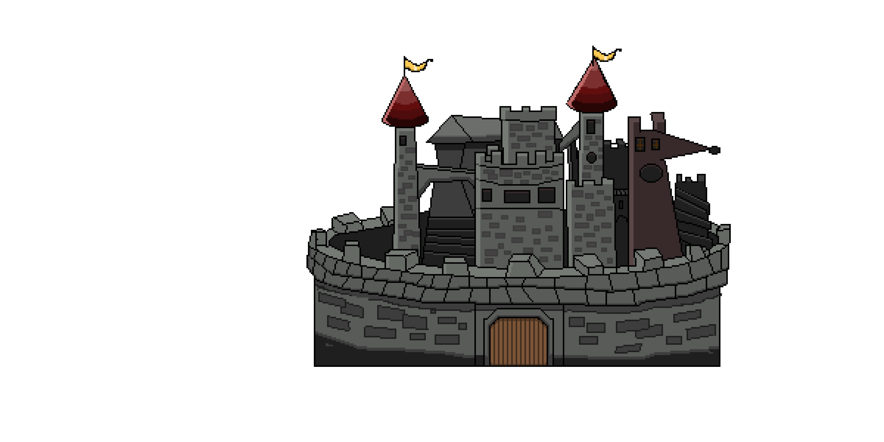
CONTEXT
We created this game with a dual purpose in mind.
-: to offer a delightful and brief gaming experience for enthusiasts who cherish the nostalgic charm of side-scrolling shoot 'em ups, akin to the classic days of Platypus.
- Our endeavor is not only a tribute to the beloved Platypus but also a passionate effort to reignite the appreciation for side-scrolling shooters, fostering a renewed love for the genre among both seasoned players and a new generation of gamers.

Slide 15
BACKGROUND
- We made this game because we wanted a new and enjoyable creative experience.
- Crafting a unique and entertaining project ignited our passion for game development.
- Our goal is to share the fun and innovation we discovered in the process, hoping players will enjoy our pixelated, retro-inspired journey.

Slide 16
BACKGROUND
- We made this game because we wanted a new and enjoyable creative experience.
- Crafting a unique and entertaining project ignited our passion for game development.
- Our goal is to share the fun and innovation we discovered in the process, hoping players will enjoy our pixelated, retro-inspired journey.

Slide 17
PART Iii
IMPLEmENTATION

Slide 18


Itch.io

Slide 19
Itch.io

Slide 20

UNITY

Slide 21
UNITY

Slide 22

UNITY ASSET STORE

Slide 23
UNITY ASSET STORE

Slide 24

PISKEL

Slide 25
PISKEL

Slide 26

Clip studio PRO

Slide 27
Clip studio PRO

Slide 28

jsfxr

Slide 29
jsfxr

Slide 30

PANDABEATSMUSIC.COM

Slide 31
PANDABEATSMUSIC.COM

Slide 32

PIXABAY

Slide 33
PIXABAY

Slide 34

Fesliyan studios

Slide 35
Fesliyan studios

Slide 36
PART IV
DEMONSTRATION

Slide 37
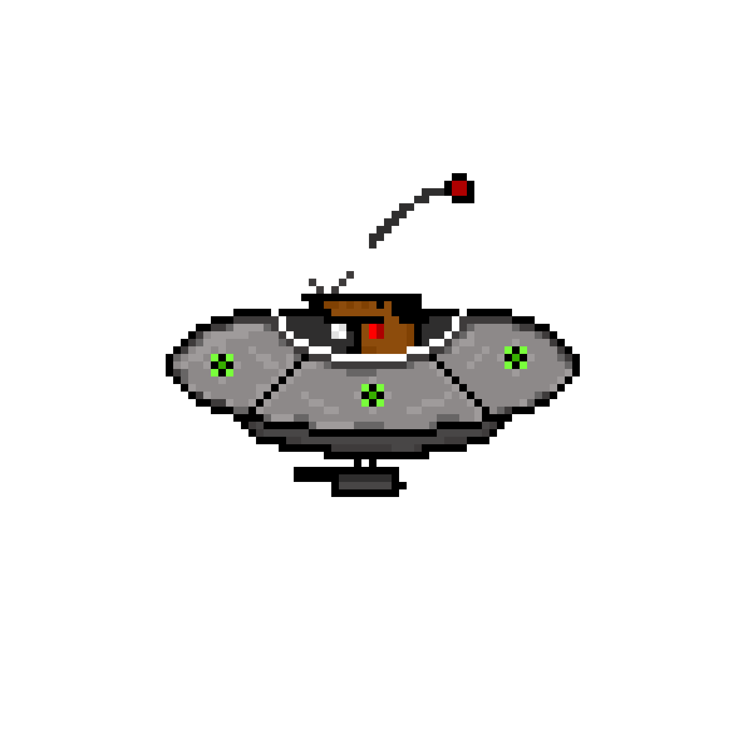
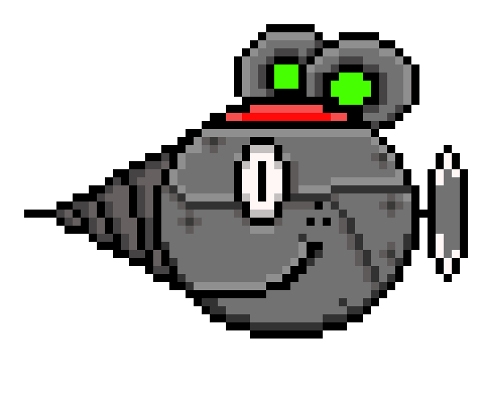
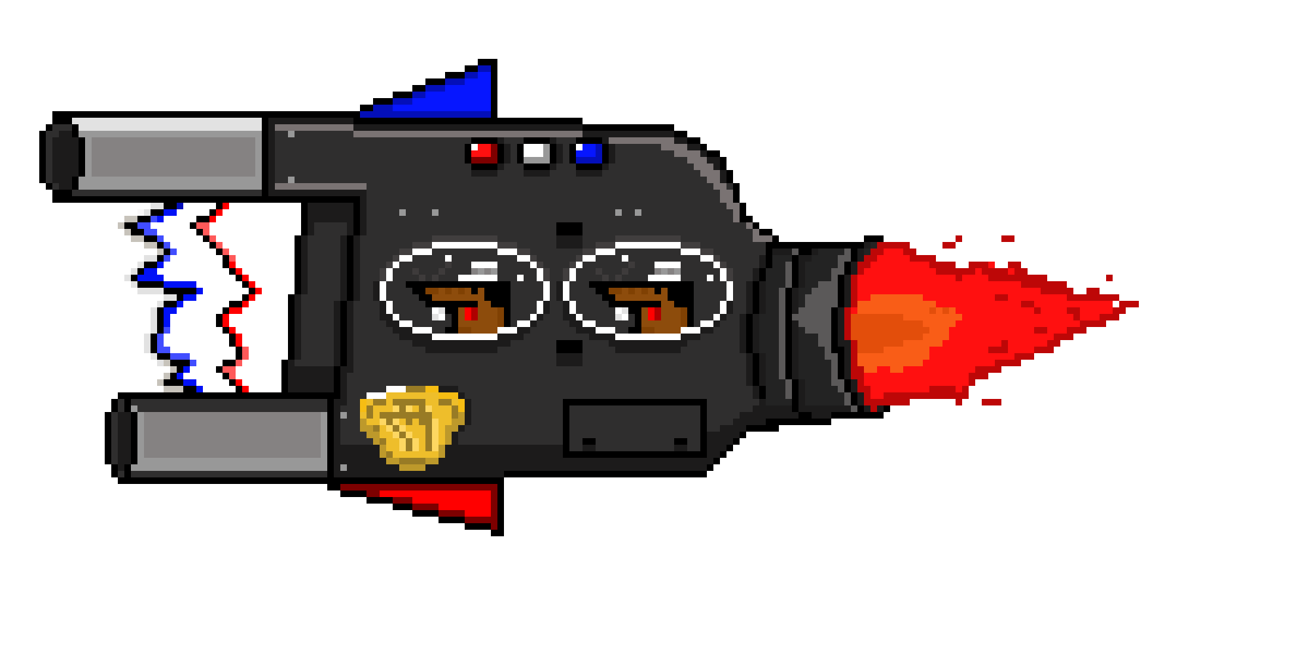
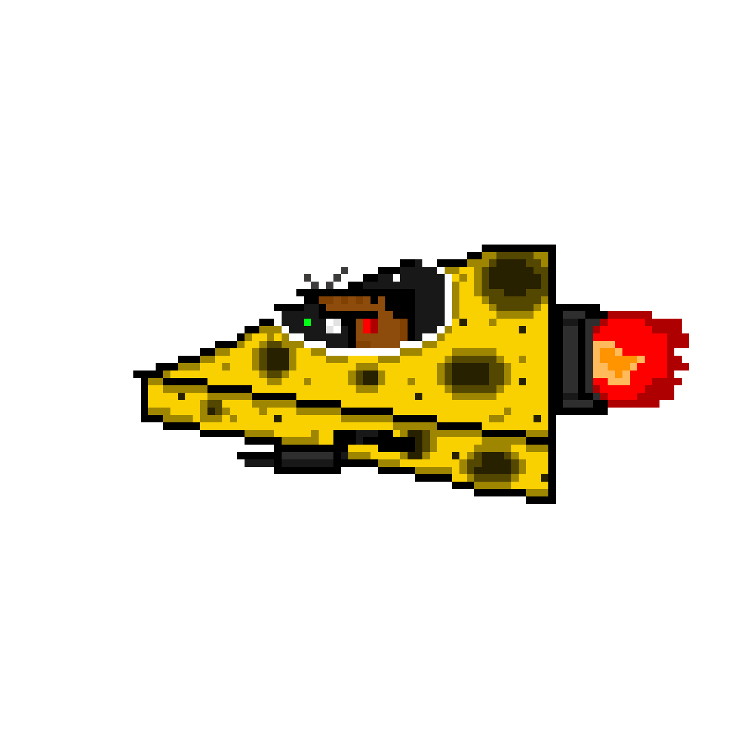
Itch.io
Level progression
1. Survive and defeat an army of Ratdogs long enough to progress through levels
2. The game gets more difficult as you finish each level
3. There will be more enemies as well as new ones the more you progress
4. The player must face against a boss at the end of the journey

Slide 38
Level progression
1. Survive and defeat an army of Ratdogs long enough to progress through levels
2. The game gets more difficult as you finish each level
3. There will be more enemies as well as new ones the more you progress
4. The player must face against a boss at the end of their journey

Slide 39
Resources
- Template used:
slidesgo.com (Retro Beach & Palms Newsletter)
Notes:
/?utm_source=slidesgo_template&utm_medium=referral link&utm_campaign=sg_resources&utm_content=freepik

Slide 40
THANK YOU!
Notes:
/?utm_source=slidesgo_template&utm_medium=referral link&utm_campaign=sg_resources&utm_content=freepik

